Slide 1
RAMP PROject presentation: Predicting air passenger traffic
MSc Data Science for Business - MAP 536
Adrien Toulouse & Paul-Antoine Girard

Slide 2
Summary
Preprocessing
Adding external data
Machine learning algorithms tried and used

Slide 3
I. Preprocessing

Slide 4
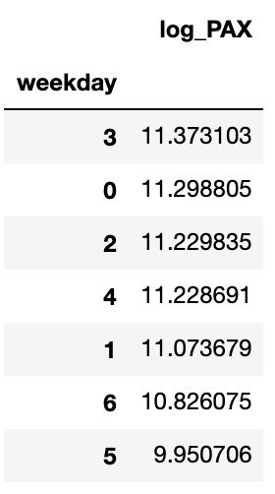
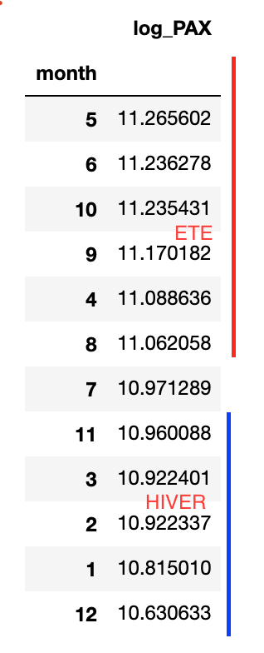
I. preprocessing
Date feature engineering:
We created 2 variables :
‘season’ based on the months
‘weekend’ based on the weekdays
Not very intuitive nor performant

Slide 5
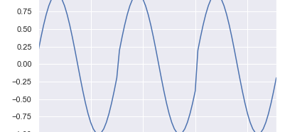
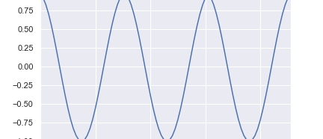
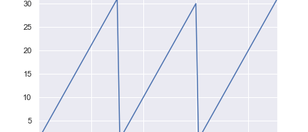
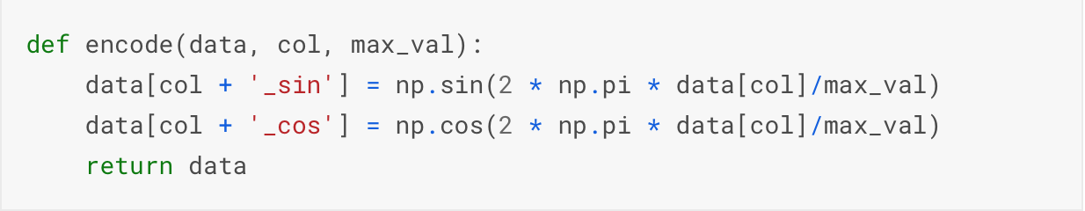
I. preprocessing
Initially the date wasn’t encoded continuously.
Algorithm didn’t know that January (represented by 1) follows December (represented by 12).
Transformation used:

Slide 6
I. preprocessing
‘Airports’
Goals:
reduce number of columns used
Add information
Realizations:
One column per airport with positive value for departing flights and negative value for arriving flights
Mean encoding
‘Reservations’
Goals:
Tackle correlation between the variables ‘WeeksToDeparture’ and ‘std_wtd’
Realizations:
PCA
Drop ‘std_wtd’
Create categories for ‘WeeksToDeparture’

Slide 7
II. Adding External Data

Slide 8
II. External data
Weather data
Very correlated variables
Didn’t explain well number of passengers
PCA and operations on the variables were not effective
‘Events’
Goals:
Replace missing values
Encode different event types
Realizations:
0 for missing values = no event
1 for common events
2 for rare events

Slide 9
II. External data
We added the following 4 variables:
Distance in kilometer between the airports:‘Distance’
Number of inhabitants per city:‘Population’
Revenue per state of the arrival airport:‘Revenue’
Crude oil price:‘Oil_Price’
Afterwards, what we could have added:
The number of planes doing the connection during the selected day
The number of canceled flights that day

Slide 10
III. Machine Learning Algorithms

Slide 11
III. Machine learning algorithms
Blending technique
Combines information from multiple predictive models.
Technique used with XGBRegressor and LGMRegressor.
Stacking technique
combines information from multiple predictive models and uses another model that perform a prediction using the predicted values of the base models.
Technique tried with XGBRegressor and LGMRegressor and KernelRidge as stacked model.
Advantages:
Learn from different algorithms
Reduce variance of predictions
Disavantages:
Increase complexity
Need to tune a lot of regressors
Increase running time

Slide 12
Conclusion

Slide 13
Conclusion
RMSE : 0.247
Circular workflow
“I only used XGB”

